Slide 1
Visit the Botanical Gardens
At Pacifica Bay

Slide 2
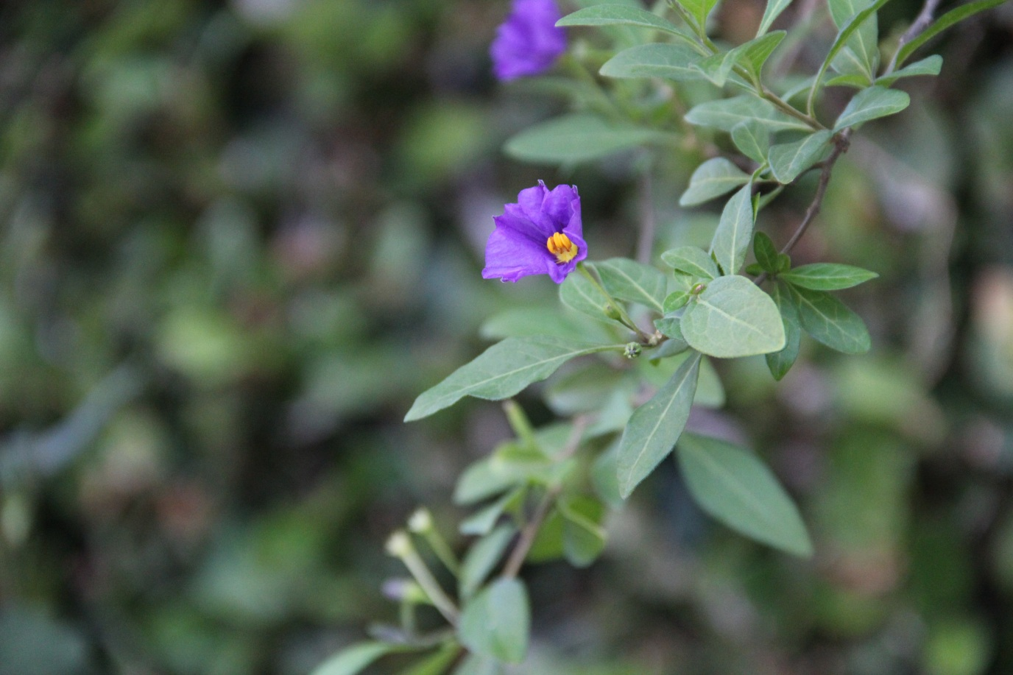
About the Gardens
Occupying over 85 acres, the Pacifica Bay Botanical Gardens are home to plant collections from around the world. The grounds are open every day from 10 a.m. until 7 p.m.

Slide 3
Key Features and Exhibits
Award-winning summer camp for children
Perennial garden and walking trail
Spring garden waterfall—a favored location for wedding and family photos
Bird and aquatic animal sanctuary

Slide 4
Enjoy Your Visit!

